Slide 1
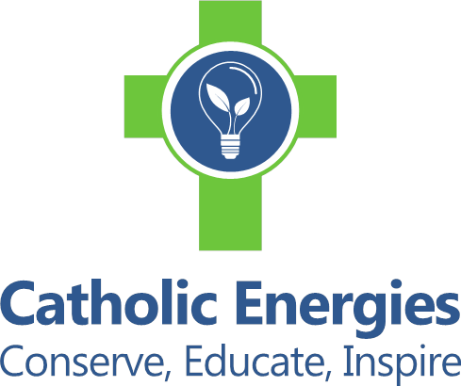
Developing and Managing Sustainable Energy
CCFM – Webinar
October 8th, 2019

Slide 2
Archdiocese of Baltimore
Leadership
Holy Father – Laudato Si
Archdiocese / Diocese /Archbishop / Bishops / Pastors / Principals
Government / Non – Profits
Parishes and Schools – Pastors / Principals / Boards
Facility Directors / Facility Managers

Slide 3
Funding & Savings
Funding for Division of Facilities and Real Estate
  Primary source of income – Cathedraticum Tax
  Minor source of income – Real Estate Fees – transaction based
Savings from Sustainable Projects
  100% of savings from sustainable projects is to the benefit of the participating entity
  Examples of sustainable projects;
    Solar Power Purchase Agreements
    LED retrofits
    Mechanical Retrofits
    Energy Audits

Slide 4
Marketing of Sustainable Projects
Selling the vision of sustainability
  Archbishop / Bishops / Pastors
  Working directly with each location
  Regional meetings
  Parish and School – Board meetings
Opposition to sustainability
  Community organizations
  Local Governments

Slide 5
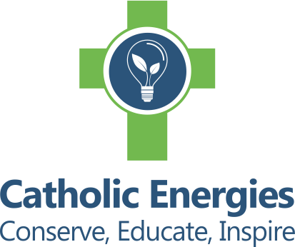
Catholic Energies
Putting Your Faith Into Action
October 2019

Slide 6
The Reality
You run faith-based, mission-focused organizations - and your facilities enable you to carry out that mission
You’d just as soon run your organizations out of a tent if you could - your buildings are not your mission – but they do take a lot of resources to run
Managing facilities is A LOT of work, and many resources are expended trying to control those costs
Every $1 you avoid paying to run your facilities can be redirected back to help fund your missions - serving others
But How Do You Accomplish This With Limited Resources?

Slide 7
Catholic Energies
Mission: Assist Catholic organizations to drive down energy costs so more resources can be redirected to mission-aligned activities.
Method: Provide Catholic organizations a turnkey solution to identify, finance and install renewable energy and energy efficiency projects.
Ministry: Ensure that organizations receive not only the support needed to execute projects, but also resources to educate and inspire parishioners, students and other stakeholders.

Slide 8
Background
Catholic Energies launched in 2016 as a program of the Catholic Climate Covenant (CCC)
CCC is a nonprofit created in 2006 to assist the Catholic community in understanding and acting on the Catholic approach to climate change - both care for creation and care for the poor
CCC enjoys support of U.S. Conference of Catholic Bishops as well as 18 national Catholic organizations

Slide 9
Work to Date
Pilot program in 2016-17 with Archdiocese of Cincinnati focused on energy efficiency projects – primarily lighting and light HVAC upgrades
Launched program nationally in late 2017, expanding to include renewable energy in 2018
Developers of the largest solar project ever completed in Washington, DC, a 2-megawatt project for the benefit of Catholic Charities of the Archdiocese of Washington
On track to complete another 2 megawatts of projects (approximately 10 projects in all) in 2019 in five states, with more ready to go in 2020

Slide 10
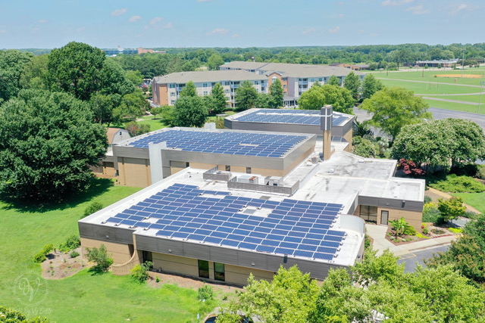
Immaculate Conception
142kW rooftop system (440 panels)
Offsetting 100% of energy consumption annually
25-year Power Purchase Agreement
14% savings compared to current electric bill

Slide 11
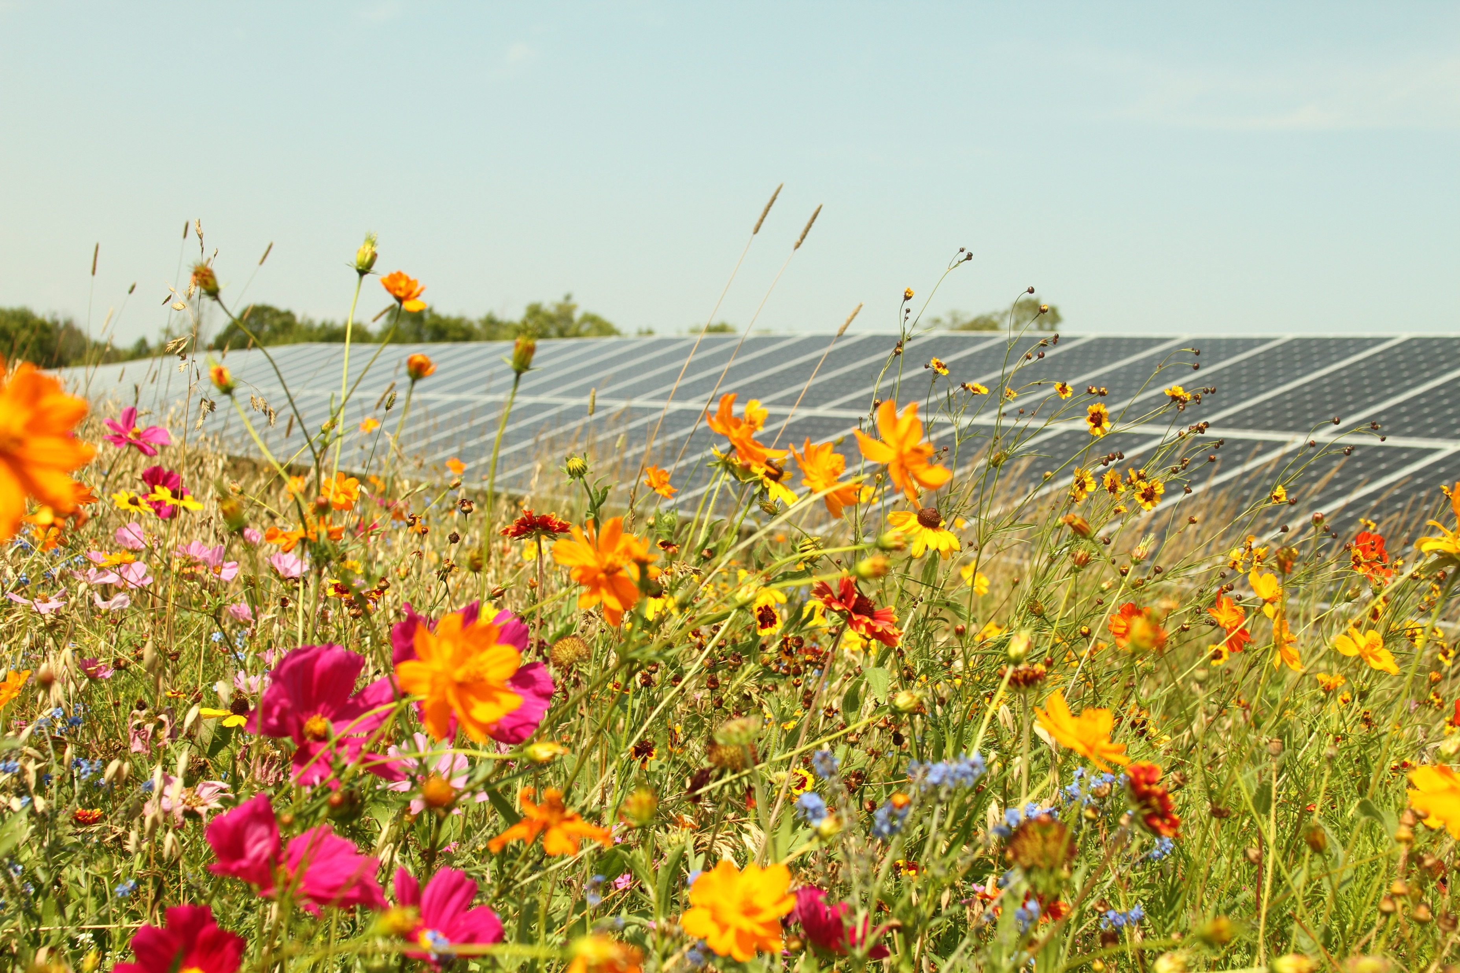
Catholic Charities - ADW
2.02MW ground-mount system (5072 solar panels)
Largest solar project in history of Washington, DC
Includes 5-acre pollinator meadow with 650,000 pollinating plants
Will save CCADW several hundred thousand annually

Slide 12
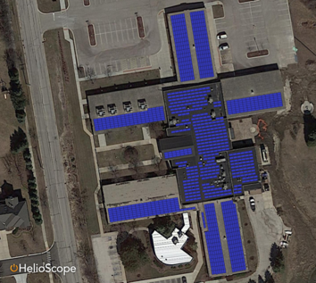
Order of Carmelites
378kW rooftop project in IL + 127kW ground-mount project in DC
20% savings compared to current electric bill
20-year Power Purchase Agreement
Offsetting 50% of electrical use

Slide 13
Why Is This So Hard?
Challenge 1: Achieving the best possible outcome for energy projects requires hard choices and substantial investment of time.
Challenge 2: There are many benefits to both pairing energy efficiency and renewable energy projects, as well as significant tax benefits available for these projects. Catholic organizations struggle to take advantage of both.
Challenge 3: Identifying trusted advisors with the technical expertise and who are mission-aligned with Catholic organizations is hard to find.
Catholic Energies Solves These Challenges

Slide 14
How We Work
Catholic Energies provides turnkey project development limiting your investment of time, personnel and money needed to execute projects.
Catholic Energies combines both efficiency and solar into a single project, enabling a reduction in both energy consumption and energy & demand costs.
Catholic Energies enables Catholic organizations to pursue these projects with no upfront cost and no maintenance risk.
Catholic Energies does not charge for this service; our fee is paid by investors if projects are successful.

Slide 15
Our Commitment
We will take the time to understand your needs – this is not a “one-size-fits-all” exercise
We will work diligently on your behalf – we work for you
We will share the details of the economics of the projects with you
We will ensure that all aspects of the project – from the materials used to the companies involved to the capital invested – are in alignment with Catholic values
We will work collaboratively with you to ensure that the project checks off more boxes than just contributing to the bottom line – we understand the moral and spiritual imperative to care for creation and care for the poor

Slide 16
How We Do It
Evaluate 12 months of electricity bills – not all bills are created equal
Create a preliminary design of the project, including projected costs and savings
Obtain a signed, non-binding Letter of Intent
Secure final project pricing and design
Execute contracts
Serve as your Owners Representative throughout the construction of the project

Slide 17
Deep Dive – Contracts
 | Power Purchase Agreement | Capital Lease | Solar Services Agreement
Duration | 15-25 Years | 5-10 Years | 25-30 Years
Who Owns Equipment? | 3rd-party investor | Catholic Organization | Catholic Organization
Mortgage Allowed? | Yes | No | Yes
Min Size (cost) | $200,000 | $100,000 | $100,000
Maintenance Responsibility | 3rd-party investor | Catholic Organization | Catholic Organization
Down Payment Required? | No | No | No
Other considerations | Buyouts offered beginning in Year 6 | May cost more than savings in early years | Will require a special assessment on property

Slide 18
What We Look For
Large services (> $3,000/month in electric spend)
Portfolio of sites under a single owner – multiple states are fine
Land that can be used for megawatt-scale or community solar projects (very state and location-specific)
Organizations committed to being leaders in their communities and the Catholic community to show how a commitment to living out Laudato Si makes economic sense

Slide 19
Another Option: Invest in Renewable Energy & Efficiency
Mission-aligned
Faith-consistent
Impact Investment
Environmental, Social, Governance (ESG) investment
Triple bottom line
Positive screening
Market rate
Scalable
Benefiting Catholic organizations

Slide 20
How Could Your Investment
Be Put to Work?
Long-term debt - 4% - 7% average
Working capital - 6% - 10% average
Revolving fund to support deals for small or unfeasible deals
Donation to support program

Slide 21
FAQ
Who are your investors? - Experienced renewable energy finance firms; Catholic Energies will begin to invest in projects in 2020
Why would they want to invest? - (1) Substantial tax benefits; (2) Revenue from PPA; (3) Mission alignment
What tax benefits? - (1) Investment Tax Credit; (2) Opportunity Zone Tax Credit; (3) Depreciation
How long are the contracts? – PPAs typically 20-25 years (with buyout and extension options), Capital Lease 5-10 years, Solar Services Agreement 10 years
What types of contracts are used? - PPA and Site Lease are both industry-standard contracts (PPA developed by National Renewable Energy Lab), Capital Lease, Solar Services Agreement
Who completes the work? - Local companies whenever possible
How long does the process take? - Once LOI is received, CE can typically secure investor and sign contracts within 30-45 days. Construction varies, but most rooftop projects are completed within 3-4 months of contract execution.

Slide 22
Questions?
CCFM – Webinar
October 8th, 2019

