Slide 1

Capital Chapter of IFMA
“REPAIR OR REPLACE”
Professional Development Meeting
February 15th, 2018
Presenters:
Ben Drake, Territory Manager / Co-Owner – The Garland Company

Slide 2
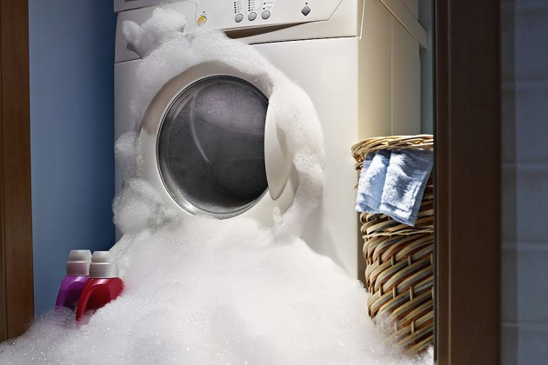
CONGRATULATIONS!!
Your Washing Machine Just Broke… ☹

Slide 3

Should you spend $200 for a repair?
Do you have $700 to buy a new one?
How many times has it broken this year?
Can you spend an entire day waiting for the repairman to show up???
How annoyed is your spouse?!?

Slide 4
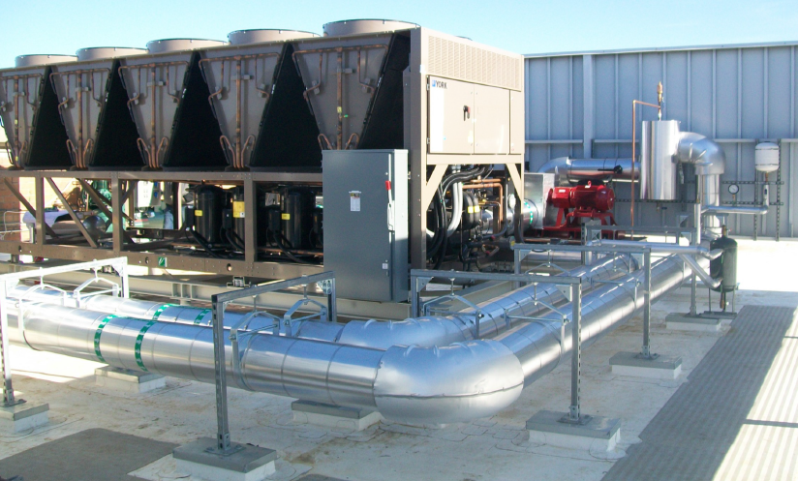
Applying this question in the Facilities world:
Should you spend $15,000 to repair your chiller or replace it with a new one? Again – it depends!
Let’s discuss what it depends on and provide a method for calculating the correct option.

Slide 5
EQUIVALENT ANNUAL COST (EAC):
A method to compare operational cost (repair) to capital project cost (replace).
REPAIR:
Cost to Repair
Remaining Life (after repair)
Annual Operating Costs After Repair (including maint & energy usage).
Salvage Value
REPLACE:
Project Cost
Projected Useful Life
Annual Operating Costs After Repair (*efficiency upgrades).
Salvage Value

Slide 6
OPTION CALCULATION
*Calculated as: Annual Cost = ((a-d/b)+c)

Slide 7

ADDITIONAL CONSIDERATIONS:
Available Funds
Reliability & Consequences of Failure
Asset near or beyond expected life
Additional Capability Requirements
Availability of Upgraded Technology

Slide 8
EAC SUMMARY:
Compares Operating Cost to Capital Expenditure Costs to make repair replace decisions.
EAC is a user friendly tool for FM’s to make data driven repair or replace decisions.
More sophisticated financial models should be utilized in order to incorporate concepts such as:
  time value of money,
  internal rate of return,
  discount rate, tax implications
  Etc.

Slide 9
LIFE CYCLE COST ANALYSIS (LCCA)
LCCA is a process of evaluating the economic performance of an asset over its entire life.
LCCA balances initial monetary investment with the long term expense of owning and operating an asset.
Life Cycle Costing is an excellent tool for comparing & selecting building assets/systems to maximize long term net savings.

Slide 10
Basic Formula for Calculating LCC
LCC = Initial + Replacement - Salvage + OM&R + Other
LCC: Total life-cycle cost in dollars of a given asset
Initial cost
Replacement: Capital replacement costs
Salvage: Salvage value less disposal costs
OM&R: Total operating, maintenance, and repair costs
Other: Total other costs, if any— (i.e. downtime costs, financing costs, etc.) *PV costs adjusted for inflation over expected life of the asset

Slide 11

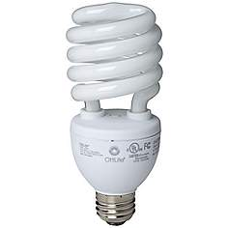
LLCA for Light Bulbs
Lets compare two light bulbs over a 10,000 hour life cycle
100 Watt Incandescent Bulb
25 Watt Compact Fluorescent Bulb

Slide 12
LCCA Light Bulb Case Study
Incandescent Bulb:
Initial Cost of 1 bulb: $5.6
Hours per bulb: 1,000 hours
Number of bulbs over 10,000 hours: 10
Replacement Cost: 5.60 x 9 = $50.40
Hours per kilowatt = 1000/100w = 10 hours
kWh of electricity in 10,000 hours = 10,000 / # of hours = 1,000 kWh
Operating Cost: $2.56 x 1,000 = $2,560
TOTAL LIFE CYCLE COST: $2,560 + $56 = $2,616
*(assuming 1 kWh cost $2.56)
Fluorescent Bulb:
Initial Cost of 1 bulb: $24
Hours per bulb: 10,000 hours
Number of bulbs for 10,000 hours: 1
Replacement Cost: $0
Hours per kilowatt = 1000/25w = 40 hours
kWh of electricity in 10,000 hours = 10,000 / # of hours = 250 kWh
Operating Cost: $2.56 x 250 = $640
TOTAL LIFE CYCLE COST: $640 + $24 = $664

Slide 13
LIFE CYCLE COST - SUMMARY
LCCA is a process of evaluating an assets cost over its entire life span “Cradle to Grave” … “Tomb to Womb”.
Excellent for weighing initial cost to cost of ownership.
Great tool for selecting one asset vs an alternative (i.e. types of light bulbs).

Slide 14
Additional Resources
Whole Building Design Guide
The Art of Trouble Shooting: “The 50 % Rule Revisited”
PlantMaintenance.Com "Repair vs Replace"

Slide 15
QUESTIONS?

