Slide 1
Facilities Manager Conference
Fall 2021

Slide 2
Introductions
Facility Stewardship
Facility Equipment Inventory
Planned Maintenance
Capital Investment Plans
Sustainability
Renewable Energies – Solar
Energy Conservation Measures Audits
Non-FM Strategies
Projects
Project Planning Considerations
Diocesan Financial Approvals
Building Commission Overview (who and how)
Divine Worship Office Approval (Fr. Weston)
FM Operations
CMMS
Contract Management
Stormwater Management
VoIP
Wrap Up, Questions and Answers

Slide 3
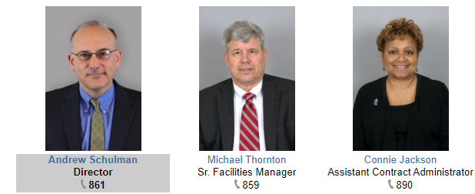
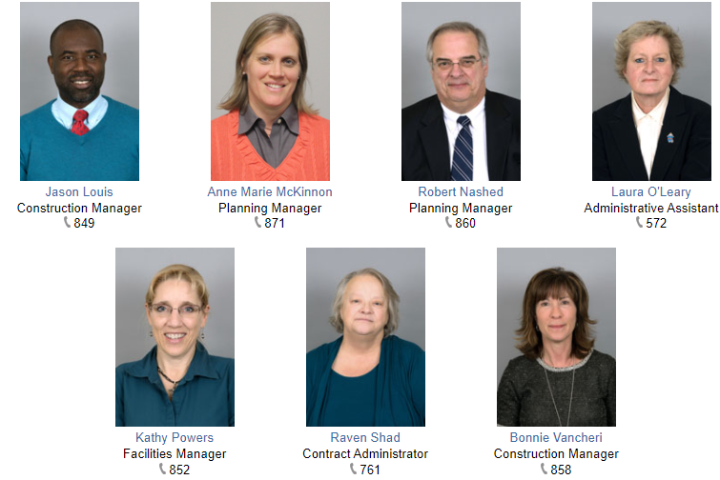
Director: Andrew.Schulman@arlingtondiocese.org
(Office Main Number) 703 841 2572

Slide 4
Facility Stewardship
Know what you have - inventory
Take care of what you have – planned maintenance
Budget for replacement – forecasting (10-year Maintenance Plan)

Slide 5
Facility Equipment Inventory
HVAC
Fire Protection Systems
Elevators
Kitchen Equipment (Hoods)
Roofs
Paving/Concrete
Electrical Systems/generators
Pews
Sound System
Stormwater Management
Security Systems

Slide 6
Planned (Preventive, Scheduled) Maintenance
Helps prevent breakdowns
Involves noticing small problems and fixing them before major ones develop
Is the juice worth the squeeze?
Required inspections

Slide 7
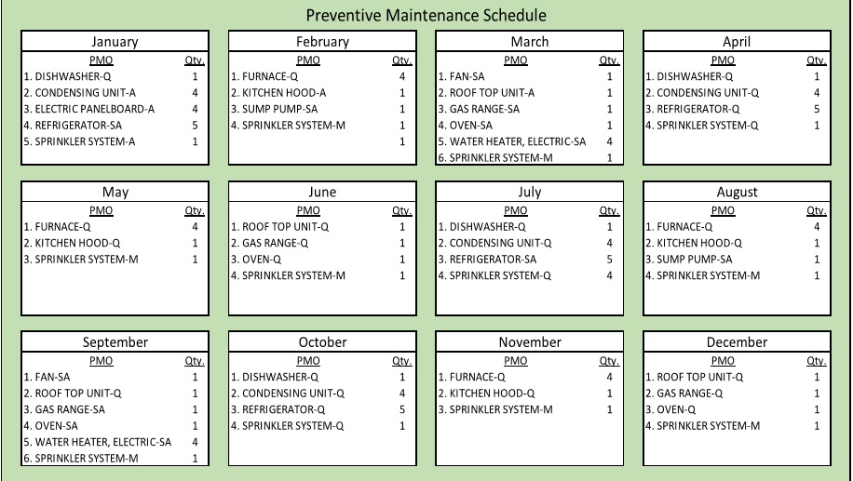
Preventive Maintenance Plans
Notes:
Include all facility systems- grounds, landscaping, facility systems- primarily HVAC, elevators, roofs, building envelope, security systems, environmental compliance
Determine periodic requirements from industry standards and or specific equipment and product data
Determine who does it- in house or contracts
Utilize a calendar to keep track, planned accomplished, deferred

Slide 8
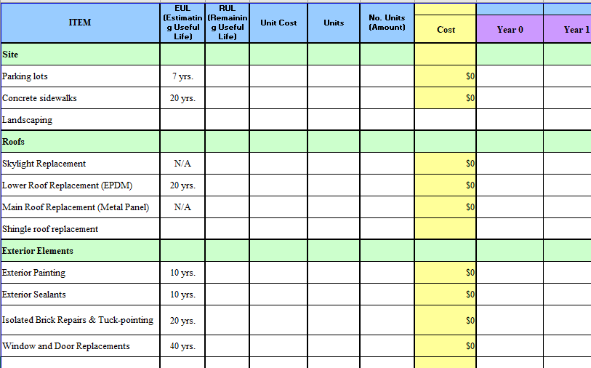
Capital Investment
Notes:
Handout document?

Slide 9
Sustainability- What is it?
Increasing importance with parishioners
Operational and facility related actions
Reduce, reuse, recycle
Provides rewarding results (think “triple win”)
Lower operating costs
Better for the environment- reduce carbon footprint
Improves public image as responsible community

Slide 10
Sustainability- How Do We Begin?
Care for Creation Committees-
Look at non-FM actions,
Examine activities to identify opportunities
Develop plan of action for operational and facility related improvements to increase sustainability

Slide 11
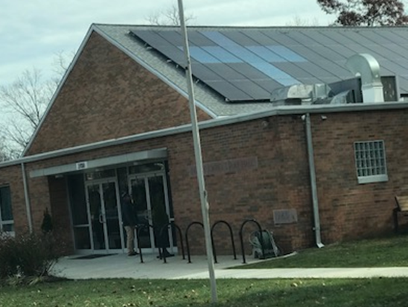
Solar Panels In Diocese of Arlington
Four Parishes have solar panels.
Our Lady, Queen of Peace (96kw)
St. Anthony of Padua (420 Kw)
St. Bernadette (470 Kw)
Church of the Nativity (75 Kw)
Installed using Power Purchase Agreements (PPAs)
Diocese has partnered with FESCO for solar panel projects, preferred rates at or less than current utility rates

Slide 12
Energy Conservation Measures
Diocese has partnered with FESCO to conduct no cost initial assessments to identify savings
Electrical- Lighting (switching to LEDs) and HVAC
Building Envelope repairs to conserve heat and cooling
Water conservation- reduce consumption

Slide 13
Natural Gas Bulk Purchasing
Why needed? Stabilize costs
Natural Gas pricing expected to rise significantly during winter
Market pricing is soaring, $0.78/therm in July 2021
US Energy Information Agency forecasts winter 2021 pricing to be $1.17/therm
Diocese working with NOVEC to provide fixed pricing for selected durations
12, 24, or 36 month contracts available
Rolling Admissions, sign up by 9th of month, for delivery following month
Be wary of cancellation fees from current provider
Other Providers available- Constellation, Dominion, WGL

Slide 14
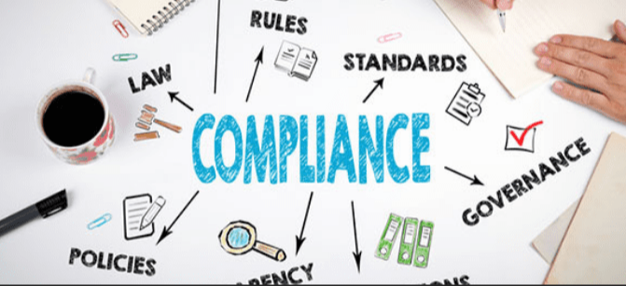
Environmental Compliance
Each building and location is subject to federal, state, local municipality laws regarding anything that affects the environment:
Municipal laws and regulations for wells, stormwater management, Conservation easements, septic tanks, and any other discharge or storage of water
These require regular maintenance, inspections, and can generate violation notices.
COMPLIANCE IS NOT OPTIONAL or as funding is available. They are considered mandatory.

Slide 15
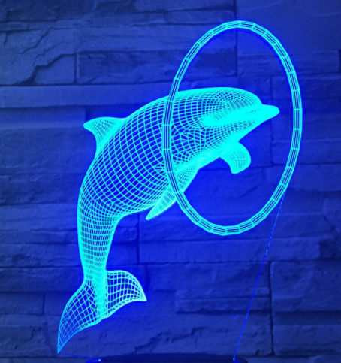
Dominion LED Rebate Program
Program is funded yearly in the fall.
First come first serve until the funds are gone.
Rebate based on fixtured installed.
Must use a participating contractor.
Contractor submits a rebate application on your behalf.
Once approved contractor installs LEDs.
Dominion inspects/accepts.
Rebate check is sent to the parish.
Dominion Non-residential Lighting Systems & Controls: domsavings.com/va/nrlsc/

Slide 16
FM Operations
Computer Maintenance Management Systems
Contract Management
Stormwater management
VOIP

Slide 17
CMMS: Computerized Maintenance Management System
Simplify managing maintenance, operations & reporting. Programs are all run from a cloud.
Dude Solutions website: dudesolutions.com
Dude Solutions representative is Michelle Auslander,michelle.auslander@dudesolutions.com919-364-6422
Estimated costs is about $2,000 a year and an initial set-up cost of $1,600.
Notes:
How many hours do I spend moving furniture?
How do I know when I need to do maintenance on the air handling units?
How much time did we spend setting up for the annual parish picnic?
How many complaints have we gotten this year about the parish hall HVAC?
How much money have we spent replacing lightbulbs in the church?
How do I convince the pastor I need a helper?

Slide 18
Contracting
Performance vs. Outcome
Statement of work
What about QA?
Contractor selection
Completion Date
Payments

Slide 19
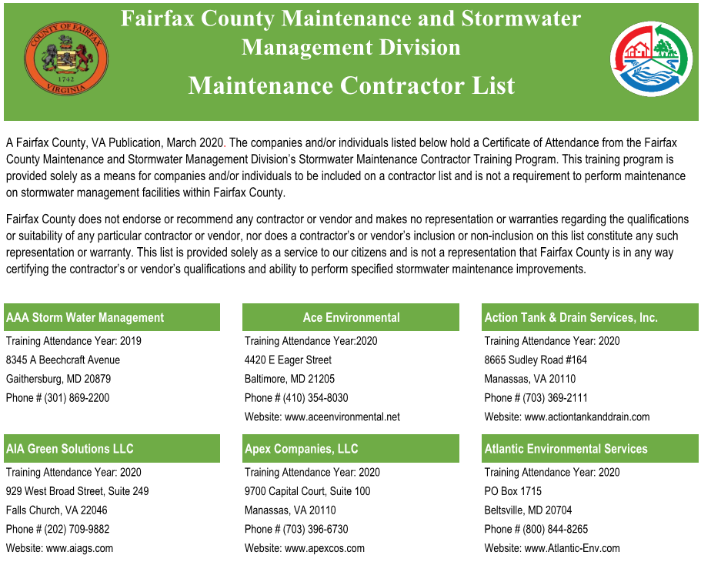
Stormwater Management
Private stormwater facilities are inspected at least once every five years.
Within approximately 30-45 days of the facility inspection, a formal Notice of Inspection (NOI) is sent via certified mail to the facility owner describing the inspection findings and any required maintenance that must be performed.
Stormwater management is still required as long as the development it was designed to treat continues to exist.

Slide 20
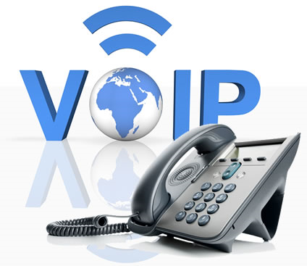
Technology Services
VoIP: Voice over IP (VoIP) telephone system
Overlays telephone services on Parish’s existing internet service
Parishes realizing significant cost savings:
St. Leo; Basilica of St. Mary; Good Shepherd; St. Catherine of Siena
E.g. Reduced 9 different phone bills totaling ~$2,000/mo. to 1 bill totaling $850/month
Can replace multiple phone systems and connect campus-wide
Conducive to in-office work and remote work
Large and small vendors

Slide 21
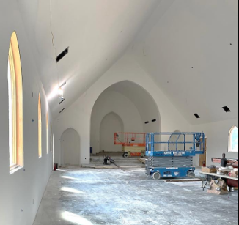
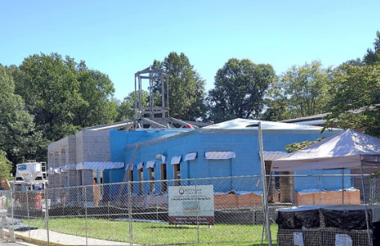
Projects
Project Planning Considerations
Diocesan Financial Approval
Building Commission
Divine Worship Office

Slide 22
Diocesan Financial Approval
Is total cost less than $30,000?
Pastor can sign contract/agreement
Is total cost $30,000 or more?
DFO approval
Project must be administered by OPCF
Does project repair or replace building systems?
Diocesan Finance Officer, Tim Cotnoir, must approve
Does project change use, footprint or capacity; or address sacred architecture?
Must proceed through Building Commission
Some projects are eligible for Streamlined Review Process (i.e., “Jiffy Lube”)

Slide 23
Project Planning Considerations
Permit needed?
Who obtains it?
Lead time?
Development Conditions or Proffers?
Stormwater Management?
Conservation Easement on the property?
Occupancy numbers or limits?
Noise limits?

Slide 24
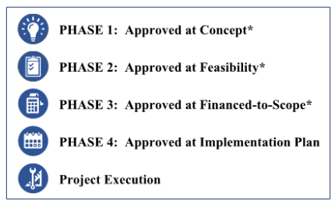
Building Commission

Slide 25
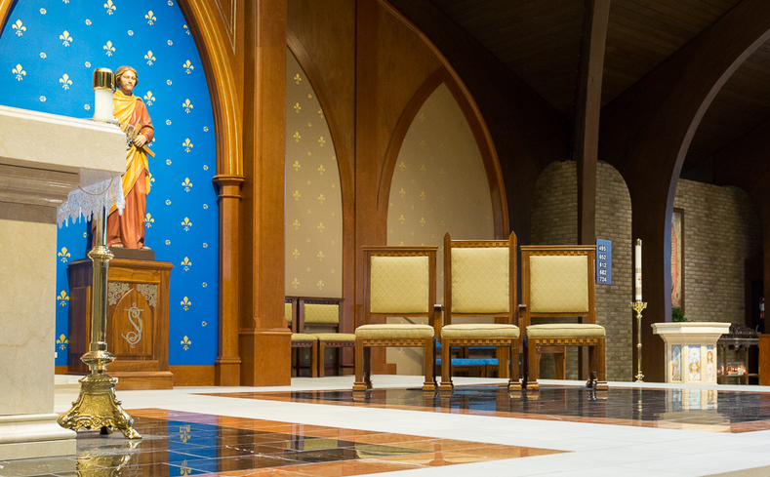
Office of Divine Worship Approval
Rev. Michael D. Weston, Director of Divine Worship, must approve architecture that alters any element of sacred liturgy.
Examples:
Confessionals
Sanctuary renovation
Baptismal font
Altar rails
Office of Divine Worship: michael.weston@arlingtondiocese.org

Slide 26
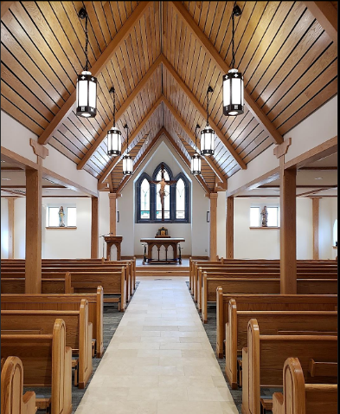
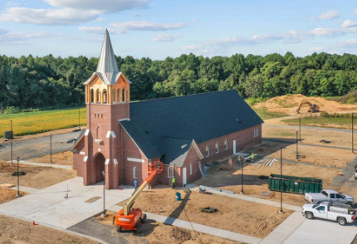
Conclusions
Assist in all aspects of facility planning and use
OPCF can leverage industry and staff talent to assist
Need to involve OPCF early to help determine most appropriate path forward.
Notes:
Queen of Apostles

Slide 27
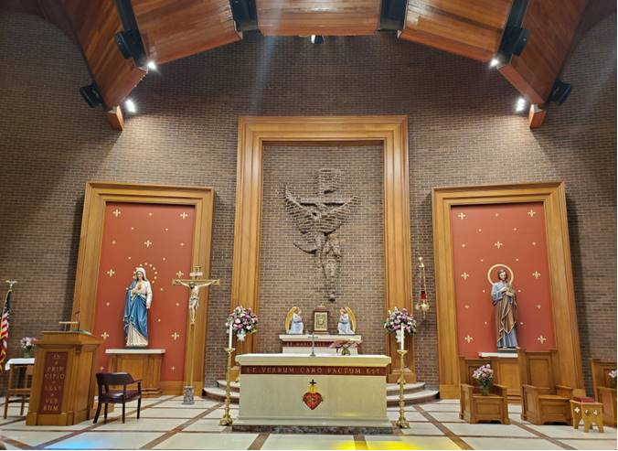
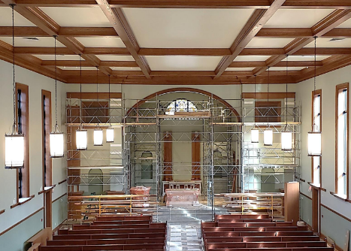
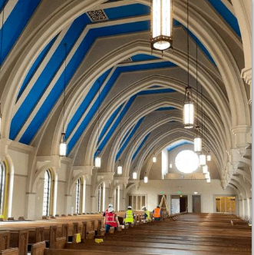
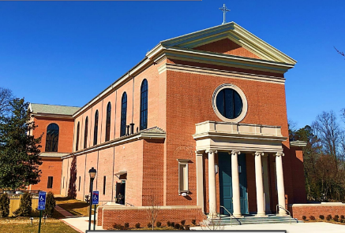
Questions?

Slide 28
Back Up Slides

Slide 29
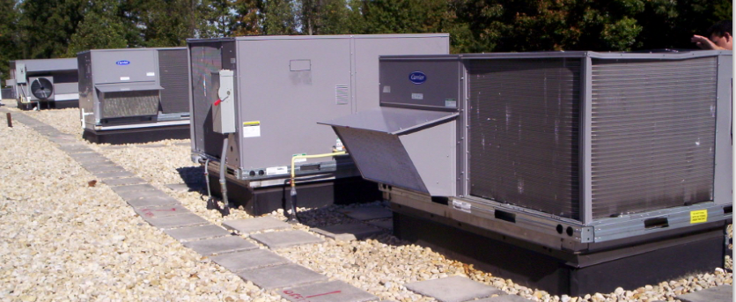
Available Assistance from OPCF
Developing scopes of work for design, construction, repairs, replacements, enlargements, or disposal
Reviewing bids for technical compliance
Review construction progress for conformance
Take samples for asbestos testing (by others)
Review maintenance plans, offer suggestions,
Develop cost models for plant replacement
Refer potential contractors
Conduct site investigations, site walks, assist with site utilization plans,
Conduct pre-construction conference with contractor and clients,
Conduct final inspections with client and contractors
Church of the Nativity Roof-top Units (RTU)
Notes:
Church of the Nativity Roof-top Units (RTU)

Slide 30
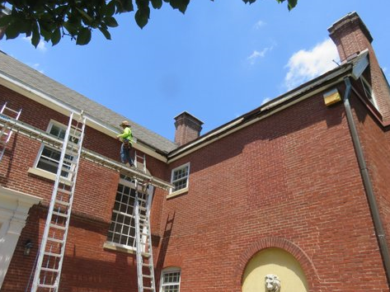
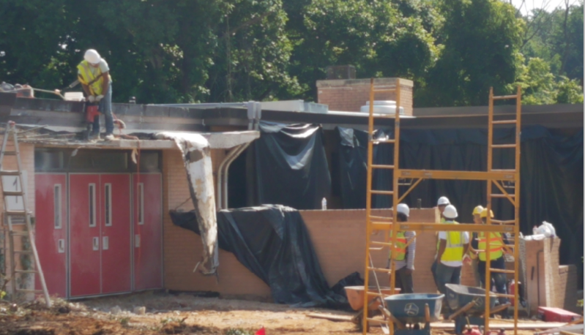
Project Process
Turnkey approach to projects - one stop shopping
Must involve OPCF on projects over $30,000.
OPCF works closely with parishes/schools throughout the project
Standard Diocesan contracts
Notes:
St. Joseph

Slide 31
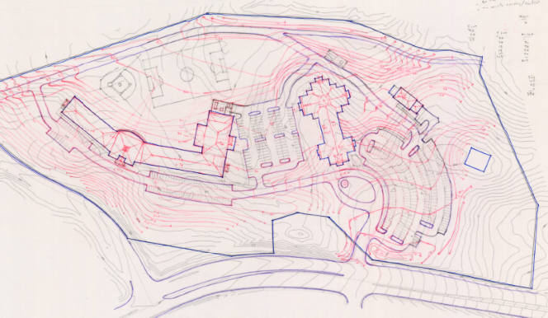
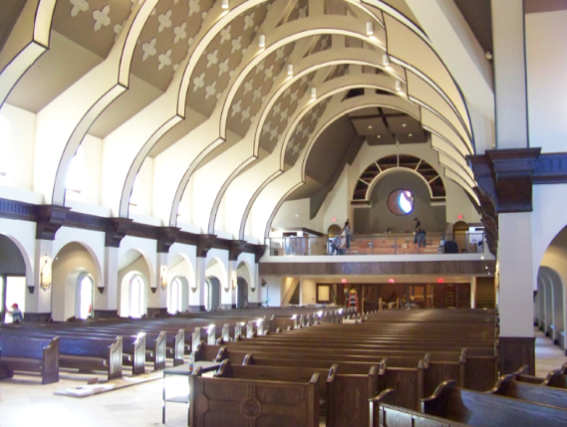
Project Timeline
Concept ~ 1 to 2 years
Preliminary Design ~ 6 months to 1 year
Design Development ~ 6 months to 1 year
Construction ~ 1 to 2 years
Commissioning ~1 to 3 months
Facility Maintenance > 50 years
Holy Trinity
Precious Blood
Notes:
Precious Blood

Slide 32
Project Planning Timeline
School Starts 8/26/19
School Ends 6/14/19
To finish a 10 weeks project during the summer recess, start your project in January!

Slide 33
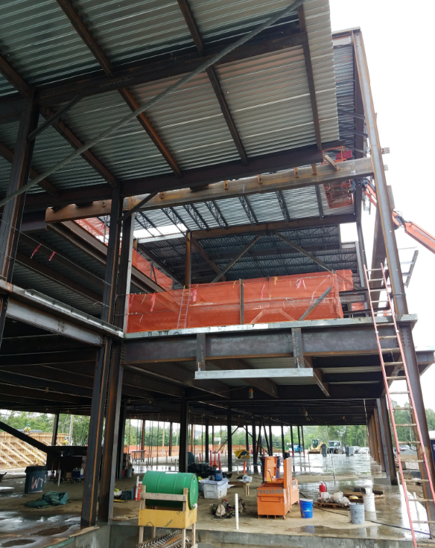
OPCF Programs:
Asbestos Materials sampling and Hazardous Materials testing- done by consultants
Sustainability
Choices in products and services to lessen the impact on the environment
Lighting upgrades
Switching to LED
Facility Conditions Assessments
Cost modeling and programming
Natural Gas Bulk Purchase
Set price for natural gas
Renewable Energy sources
Solar Power to provide some
electrical energy

Slide 34
Keeping Track
How many hours do I spend moving furniture?
How do I know when I need to do maintenance on the air handling units?
How much time did we spend setting up for the annual parish picnic?
How many complaints have we gotten this year about the parish hall HVAC?
How much money have we spent replacing lightbulbs in the church?
How do I convince the pastor I need a helper?

Slide 35
Building Commission

