Slide 1

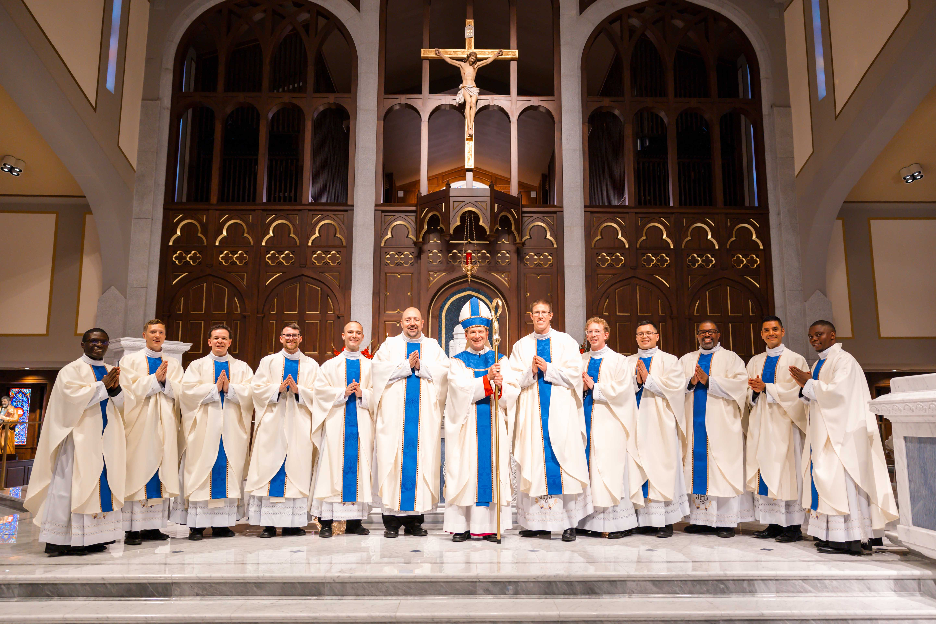
BISHOP’S LENTEN APPEAL 2026
WEBINAR For Parishes
JANUARY 28, 2026
Notes:
Bishop Burbidge

Slide 2
In Christ, We Are One
Heavenly Father, you have revealed to us the wondrous mystery of the life of the Most Holy Trinity, dwelling in eternal communion with your Son and the Holy Spirit.
May our generosity to the Bishop’s Lenten Appeal, foster in us an abundance of your gifts so as to be united with you and with all of our brothers and sisters in the human family.
Through our Lord Jesus Christ, your Son, who lives and reigns with you in the unity of the Holy Spirit, God, for ever and ever. Amen.

Slide 3
THE 2025 BLA WAS THE MOST SUCCESSFUL EVER!
Thank you to all of you who made the 2025 BLA a success!
Over $24.1 Million in pledges!
This funding is vital to our diocesan mission to spread the Gospel with direct impact on each parish, each priest and all parishioners.
The BLA funds 40+ programs and ministries that assists thousands of people in our diocese.
Participation by households remained steady at 36,283
Notes:
Bishop Burbidge

Slide 4
2025 Bishop’s Lenten Appeal
Recap (as of 1/27/26)
Year #of Gifts Mail In Pew Online Total
2023: 36,108 (+431) $10,756,479 49% $4,449,299 20% $6,627,761 30% $21,833,539
2024: 36,320 (+212 ) $10,946,903 47% $4,656,430 18% $7,484,440 32% $23,087,773
2025: 36,283 (-37) $11,342,782 47% $4,645,844 19% $8,145,216 34% $24,133,842
Mail
  14,205 gifts from the mail – increased by $395,879. Average gift $771.
In Pew
  11,500 gifts from in-pew (plus online). Average gift $405.
  Adding Online Giving / QR Code option during Mass has led to more online gifts
  Using the envelope continues to be effective.
  Pastor’s personal involvement makes the difference.
  It’s important to seek gifts from those who are not registered, thus have not received BLA mailings.
  Online
  10,615 gifts from online – increased by $660,776.
  Online gifts have the highest average amount
  Online gifts increase fulfillment of pledges, when made online with monthly payments.
  Fulfillment rate in 2024 and 2025 is ~96%.
Notes:
Bishop Burbidge

Slide 5
2026 BLA Strategy:
Increase # of participating families
Encourage Online
Encourage Monthly Recurring Gifts
  Participation Goal
    37,000 Families (up from 36,283 in 2025)
    38,000 Families - Challenge
  Financial Goal
  $24 million ($24 million raised in 2025)
  Online
  Encourage use of phone to make gift online
  Monthly
    Encourage monthly recurring gifts (similar to offertory)
Notes:
Bishop Burbidge

Slide 6

Key Dates
BLA Letter # 1 from Bishop - Mailed January 20
BLA Lay Speaker Talks – January 25
Announcement Weekend – February 1
Parish Email – February 2
Commitment Weekend – February 8
Follow-Up Weekend – February 15
Parish Email – March 16
BLA Letter #2 from Pastors – March 18
  Please submit Letterhead, Signature, Approved Letter

Slide 7

In-Pew Process
Encourage use of the QR Code
Trained Volunteers at each Mass
Pre-Load Golf Pencils
Volunteers – Hand out envelopes
Collect Envelopes at the In-Pew
Review envelopes w/ parishioners

Slide 8
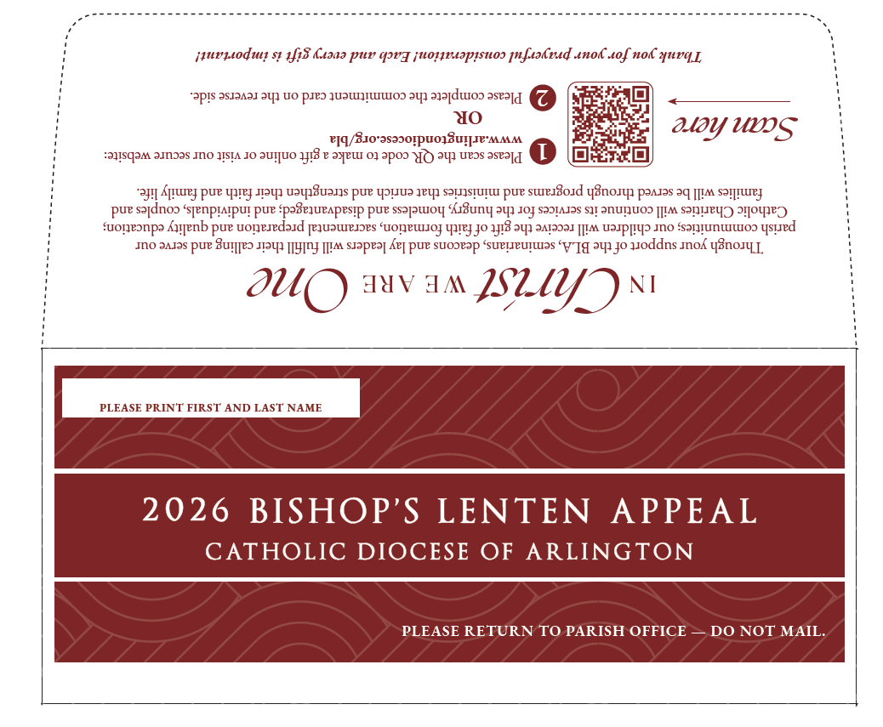
In Pew Envelope
Encourage
Online Gifts

Slide 10
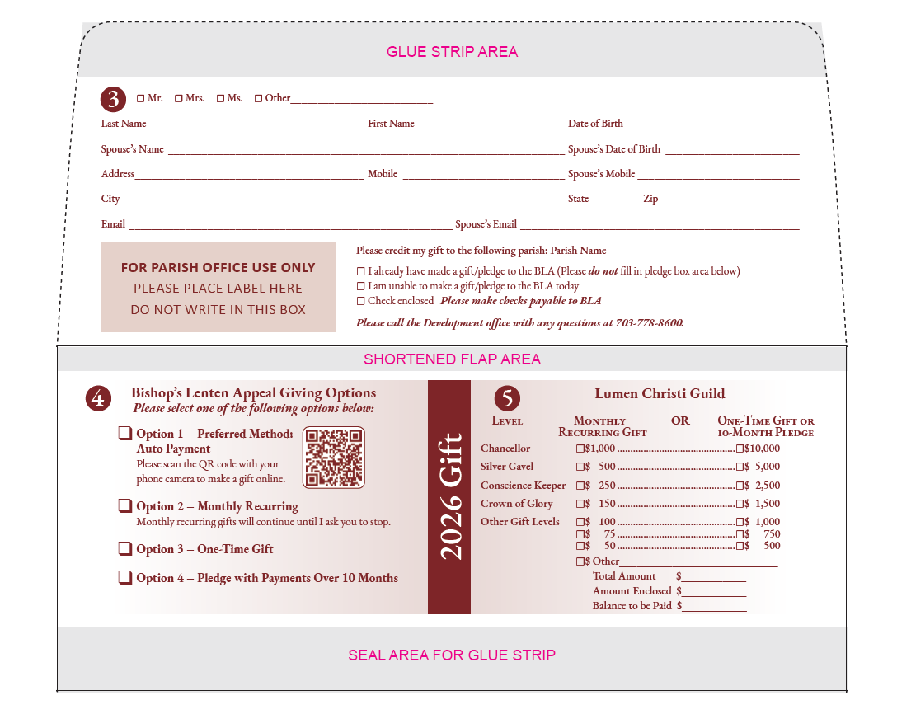
Online /
Monthly Recurring
Preferred Option.
One-Time and Pledge Gifts
Continue to be accepted.

Slide 11
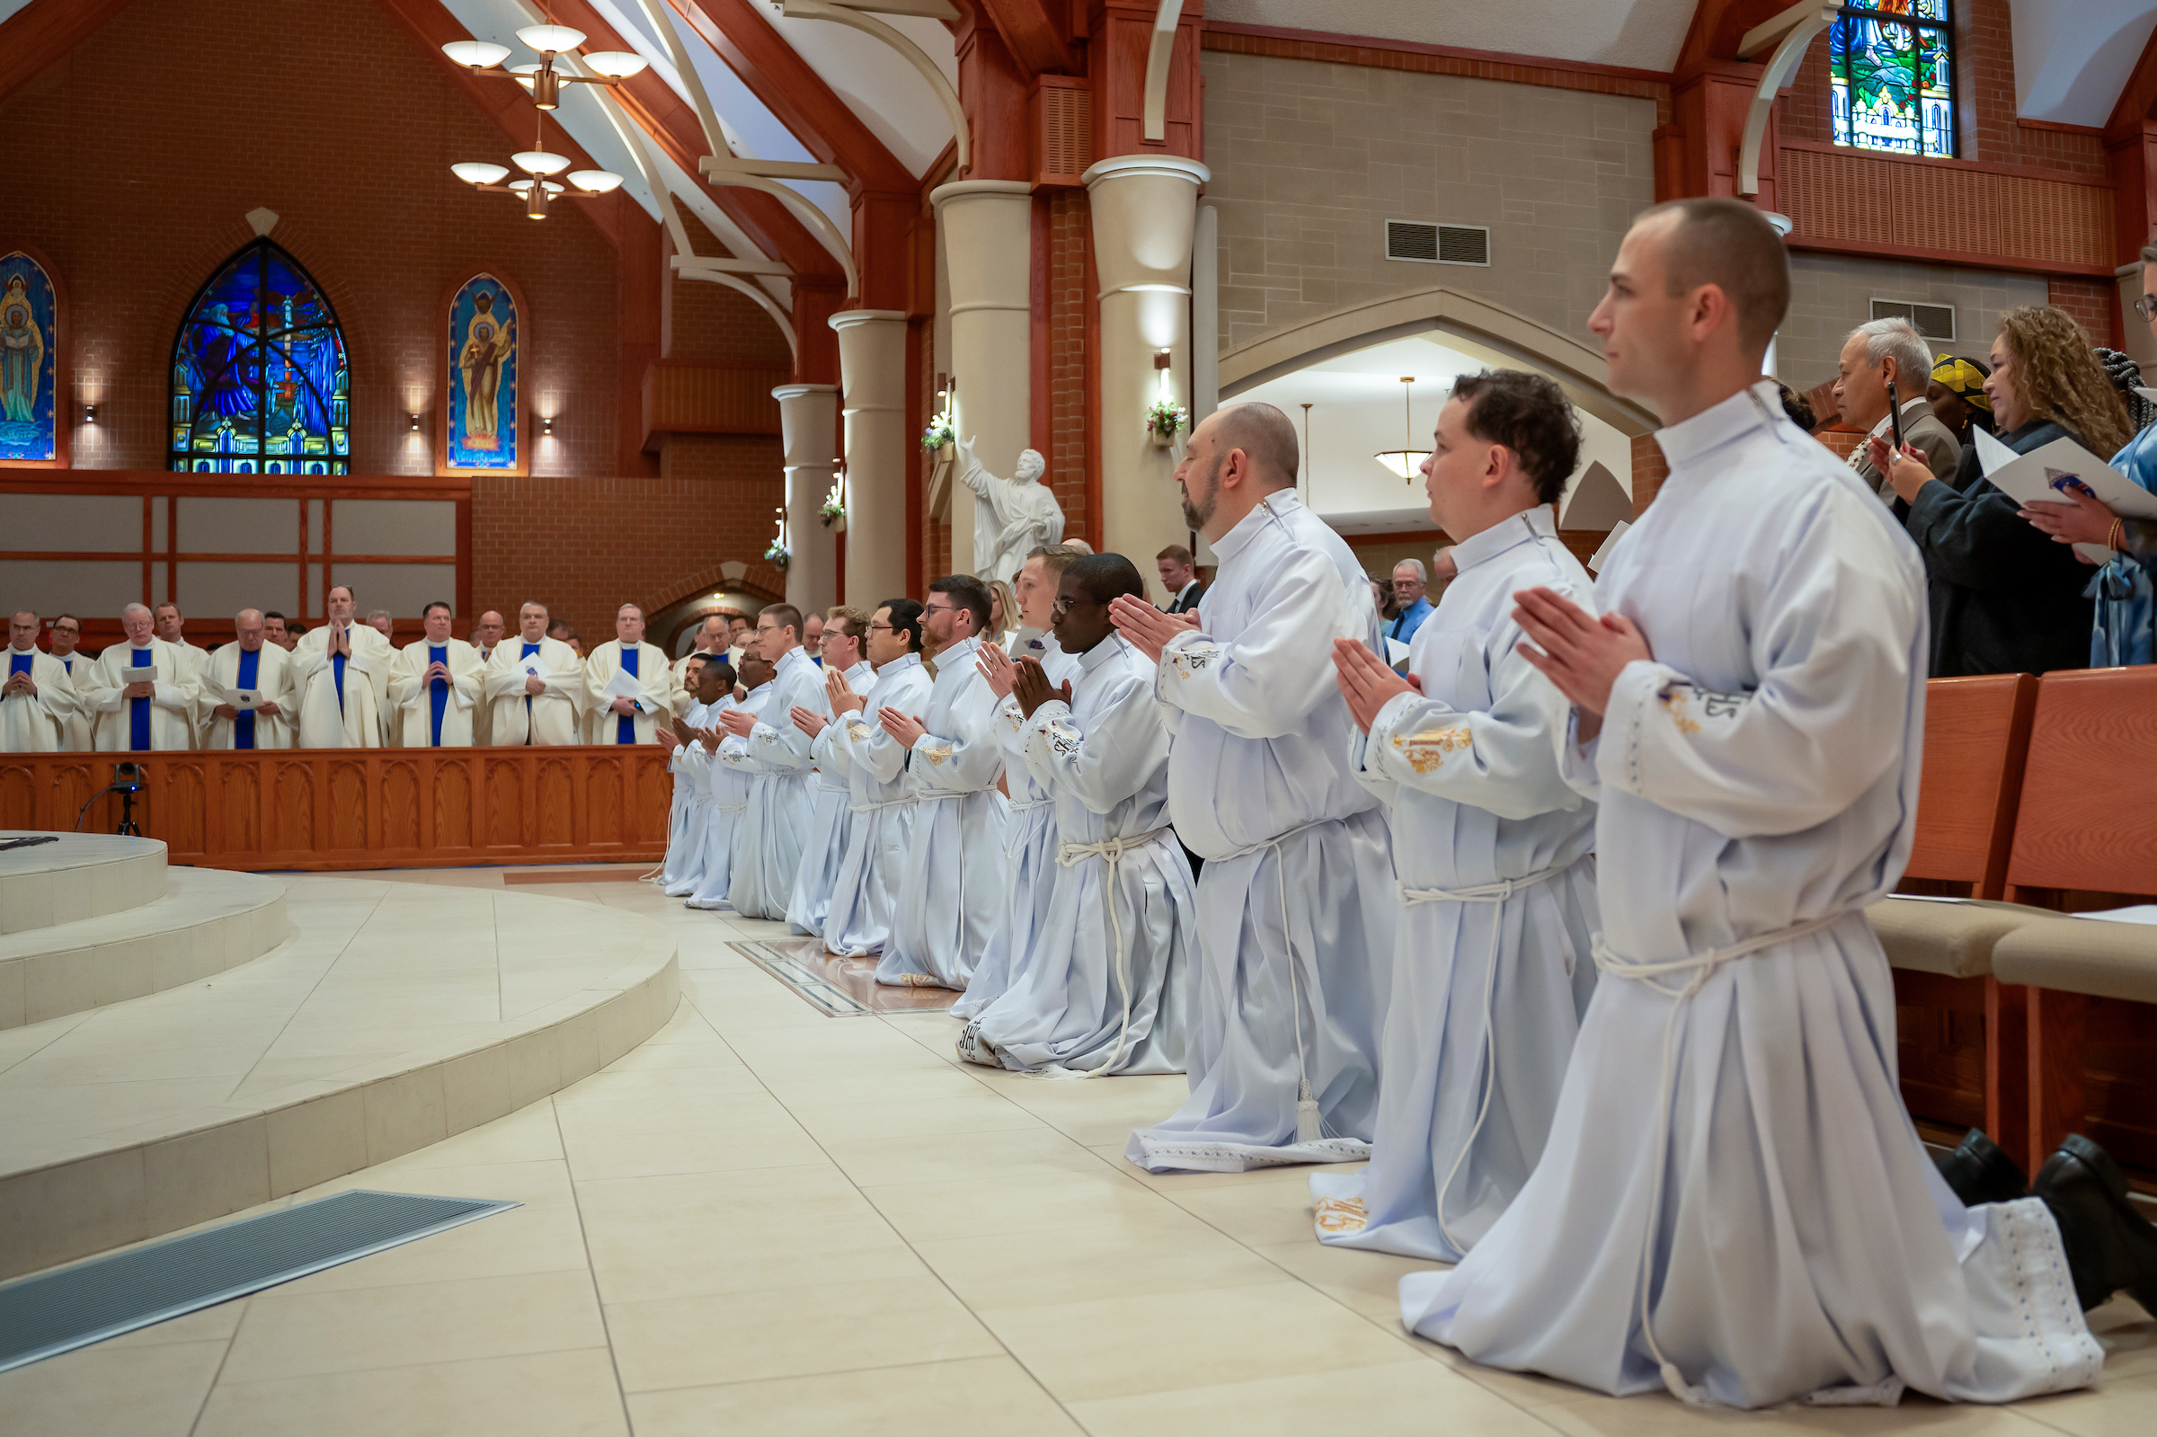
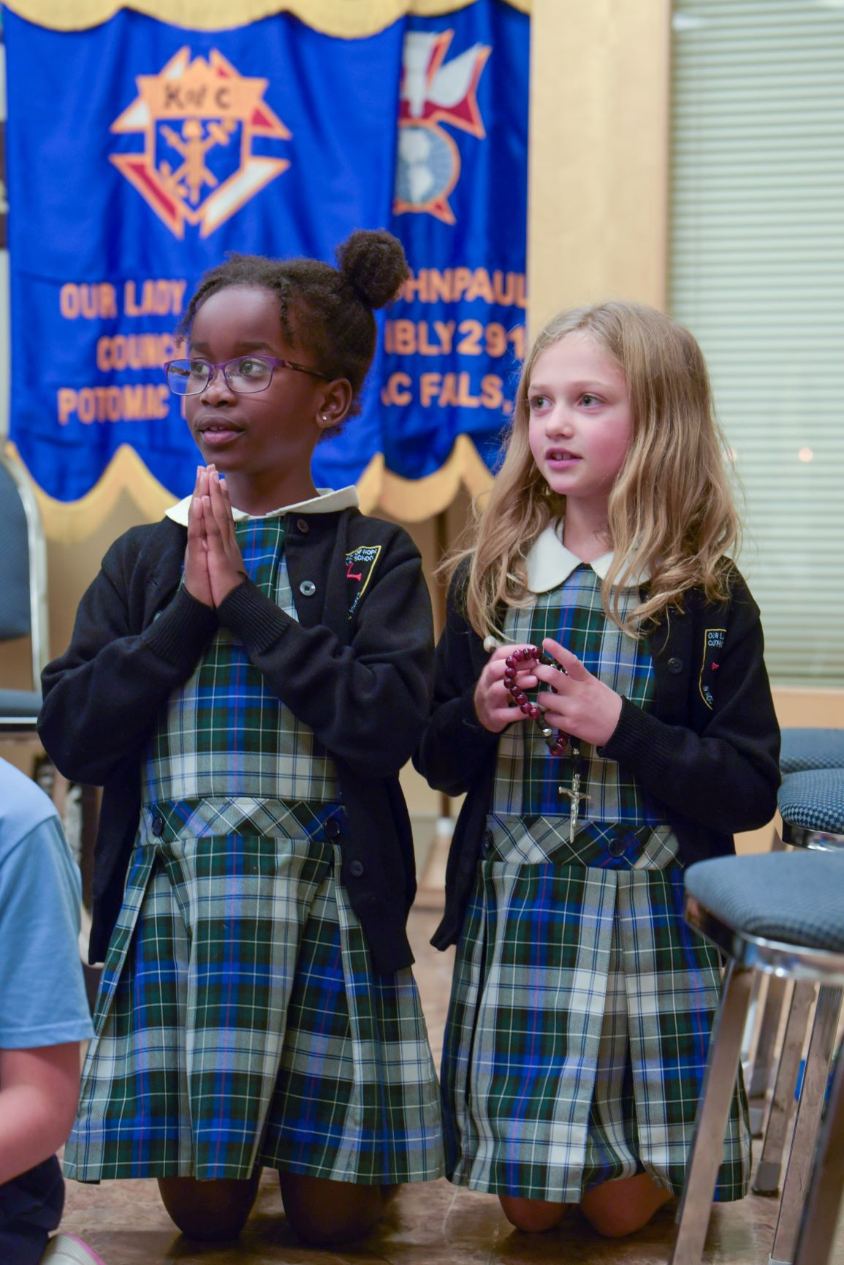
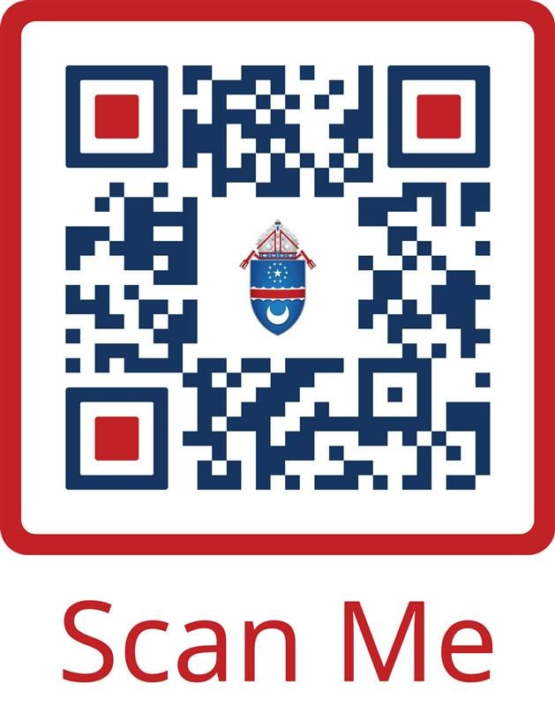
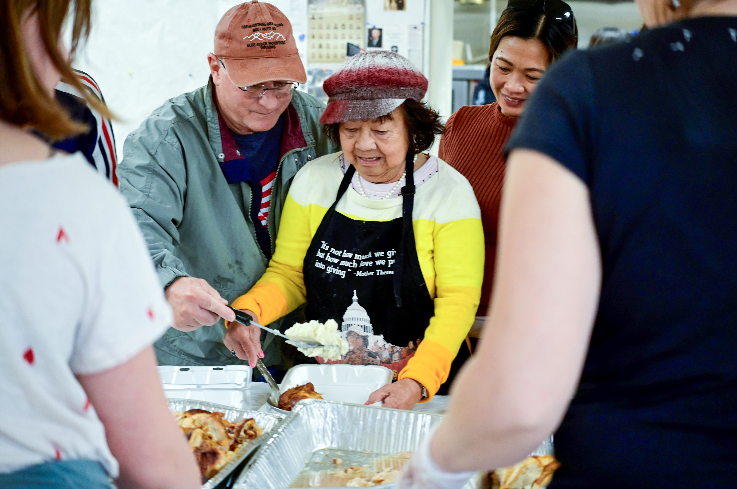
BLA in Action
Notes:
Peter de Keratry

Slide 12
arlingtondiocese.org/ development/bla/parish-materials/
Homily / Pulpit talking points
Introduction Weekend
Commitment Weekend
Follow-up Weekend

Slide 13
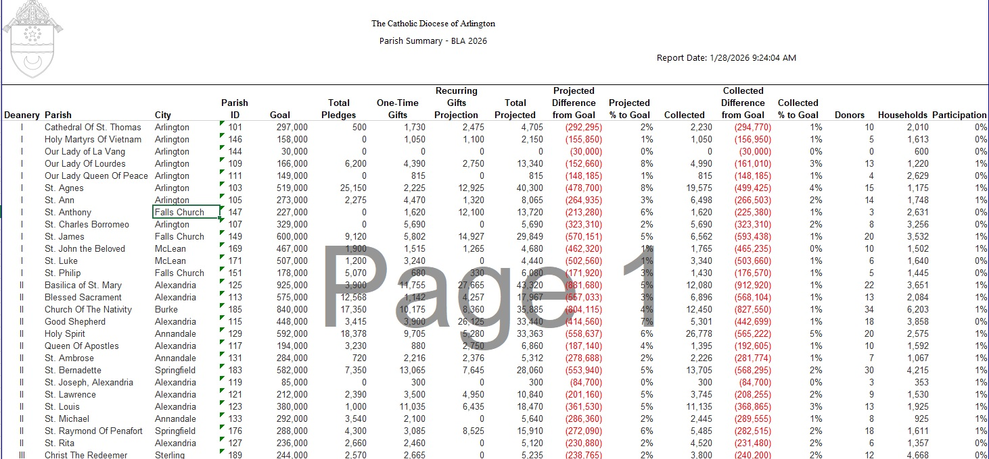

Slide 14
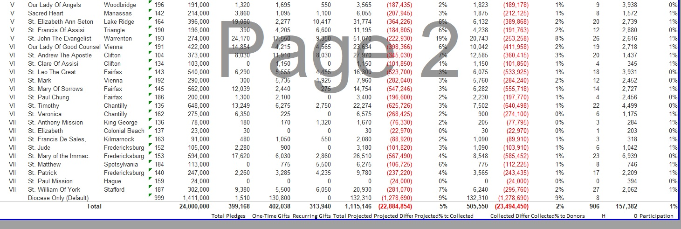

Slide 15
Questions?
Thank you! arlingtondiocese.org/bla development@arlingtondiocese.org
703-778-8600

